Slide 1
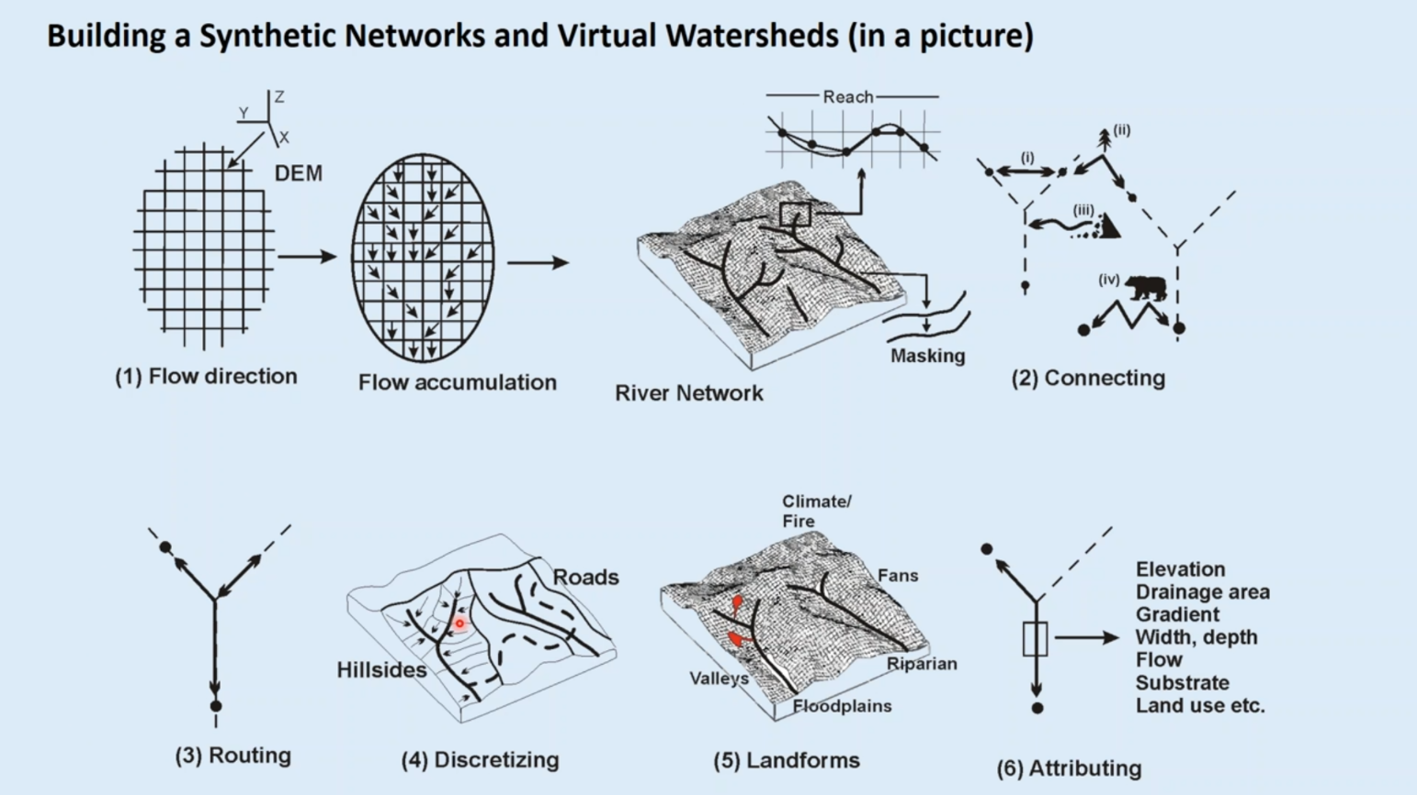
Future Work Recommendation: Hydrogeomorphic Analysis of Ash Creek Sub-Basin
Proposed Project Activities
Develop basin-scale hydrologic and channel network models from available 1-m LiDAR digital elevation data
Compile existing topographic, geologic and soil survey data to create basin-scale geomorphic base map (landforms, materials)
Field validate derived hydrogeomorphic models at select calibration localities
Conduct background hydrogeologic investigation of groundwater conditions and aquifer characterization
Project Leads: David Szpakowski and Steve Taylor
Project Collaborators: Bryan Dutton, WOU student assistants
Support Staff: Beeb Singson

Slide 2
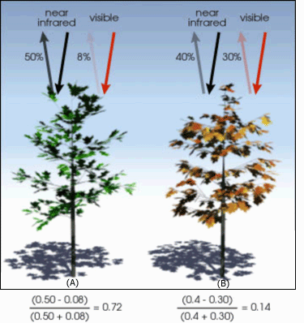
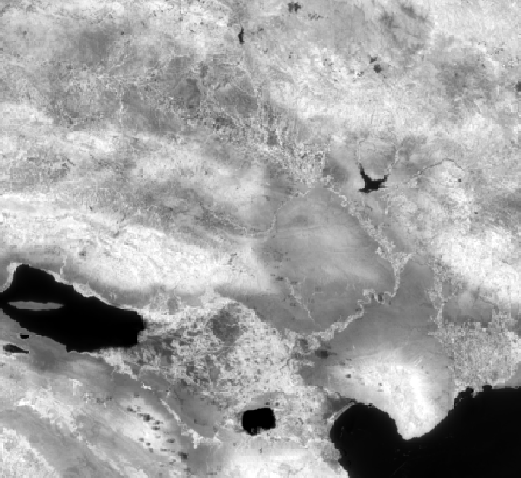
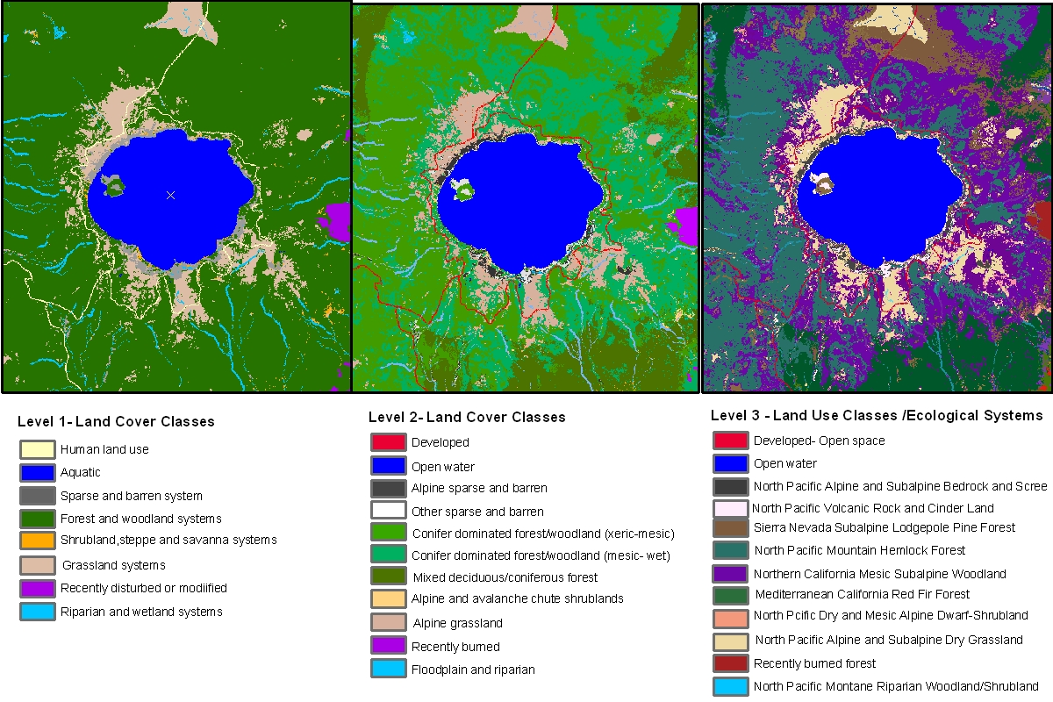
Future Work Recommendation: Future Drone Image Collection and Classification
Proposed Project Activities
Test ability to identify invasive species during different seasons
Utilize UAV with NIR sensor to aid in species identification
Determine the applicability of machine-learning classification tools (supervised and unsupervised) to categorize vegetation along Ash Creek
Explore use of UAV to derive Structure-from-Motion surface models for hydrogeomorphic analysis

Slide 3
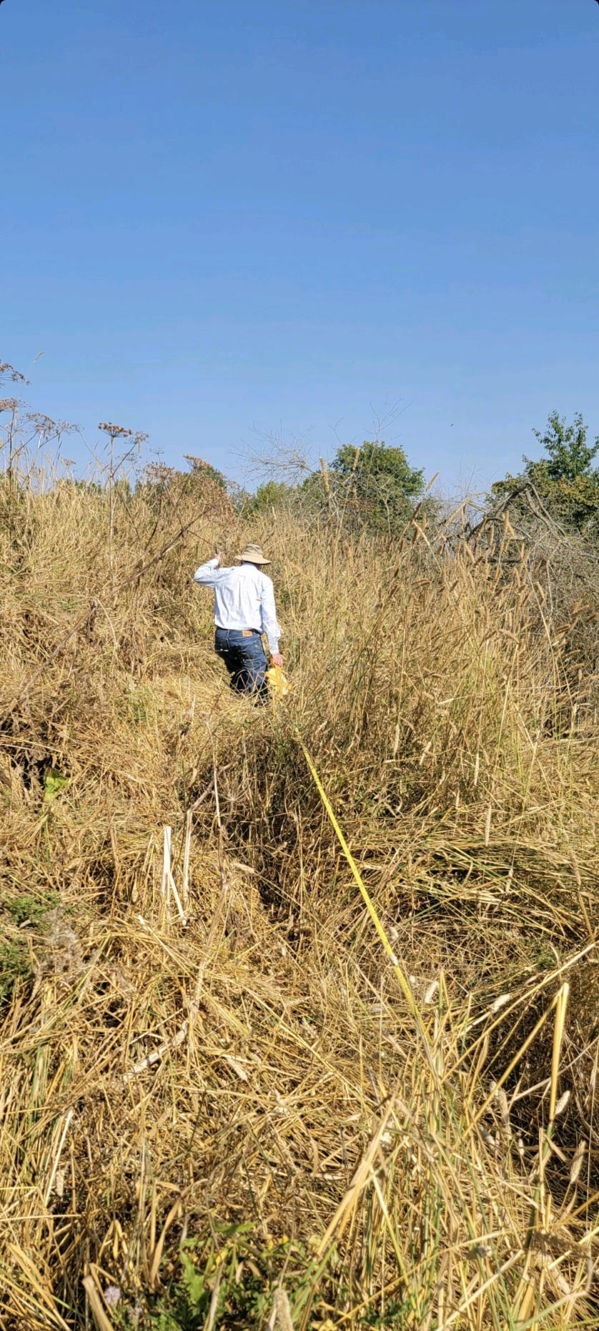
Future Work Recommendation: Surveying and Monitoring
Proposed Project Activities
Develop and refine a survey protocol that meets the needs of the ACWCD Board, e.g.:
  Transects
  Transects + Survey Grids
  UAV imagery
  A combination of the above
Create an inventory of plant species of concern currently found in the watershed (e.g., reed canarygrass, Himalayan blackberry, knotweed) to an appropriate scale for the sub-basin
Develop and refine a long-term monitoring protocol of populations of plant species of concern (based on survey results) that meets the needs of the ACWCD Board, e.g.:
  Photopoints (landscape of feature photographs retaken from the same spot filling the same frame)
  UAV imagery
Source: Hall, Frederick C. Photo point monitoring handbook: Part A-field procedures. US Department of Agriculture, Forest Service, Pacific Northwest Research Station, 2002.

Slide 4
Community Outreach
Education: WOU Undergraduate Students
Research and Service
Ash Creek Watershed
Our Vision
Community Outreach: the watershed is a perfect vehicle for informing the local community about the environment in which they live
Education: field-trips and fieldwork in the watershed offer extensive opportunities for experiential and service learning in Natural Science
Research: collaborative faculty / student, project-driven research (such as our current work) is a hallmark of the experiences Natural Science faculty provide our undergraduates
Ash Creek: the proximity and scale of
the watershed make it an ideal venue
for developing local Natural Resource partnerships at WOU

