Slide 1
Ash Creek Project Meeting
Western Oregon University
Welcome Ash Creek Water Control District Board Members and Guests
Agenda:
6:00 pm - Introductions
6:05 pm - Revisit Work Completed
6:35 pm - Future Work Presentation
6:45 pm - Open Discussion

Slide 2
INVASIVE PLANT RECONNAISSANCE SURVEY IN THE ASH CREEK WATERSHED, POLK COUNTY, OREGON
Prepared By:
David Szpakowski*, Bryan Dutton^, Stephen Taylor*, Joseph Brooks*, Anastasia Popchock^, Hannah Porter^, Beeb Singson*, and Heather Tovar^
Division of Natural Sciences and Mathematics
Western Oregon University
Monmouth, Oregon 97361
(*Earth and Environmental Science Department; ^Biology Department)
Prepared For:
Ash Creek Water Control District
P.O. Box 81, Independence OR 97351

Slide 3
PROJECT DELIVERABLES
(1) Development of one, or more, methods for surveying reed canary grass, Himalayan blackberry, Japanese knotweed, and English ivy at select sites along the Ash Creek Watershed
(2) Description of survey results, how these results can be used, and the costs associated with the methods.
(3) Site-specific survey summaries:
Distribution data on species populations of interest
Digital photographs of each population of each respective species
GPS coordinates and GIS data format
Literature survey and synopsis for invasive species of interest

Slide 4
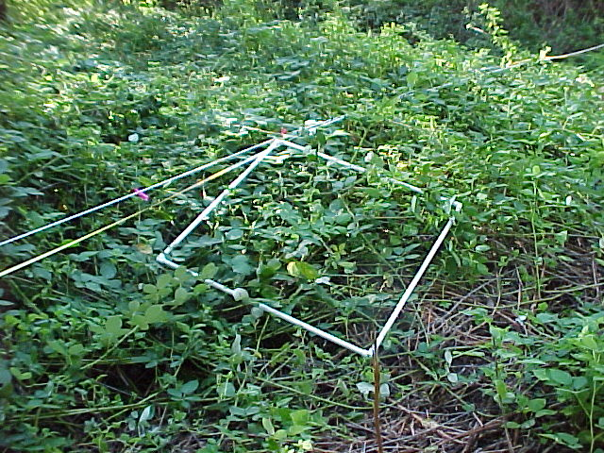
OVERVIEW OF FIELD-BASED PLANT SURVEY RECONNAISSANCE
Methodology
Seven field survey sites selected according to property access
18- to 25-meter riparian transect lines established parallel to channel reaches
1-square meter moving survey window along each transect, all plants identified, field data recorded, with visual estimate of percent cover
Invasive plant species of interest:
  Fallopia japonica – Japanese knotweed
  Hedera helix – English ivy
  Phalaris arundinacea – reed canarygrass
  Rubus bifrons – Himalayan blackberry

Slide 5
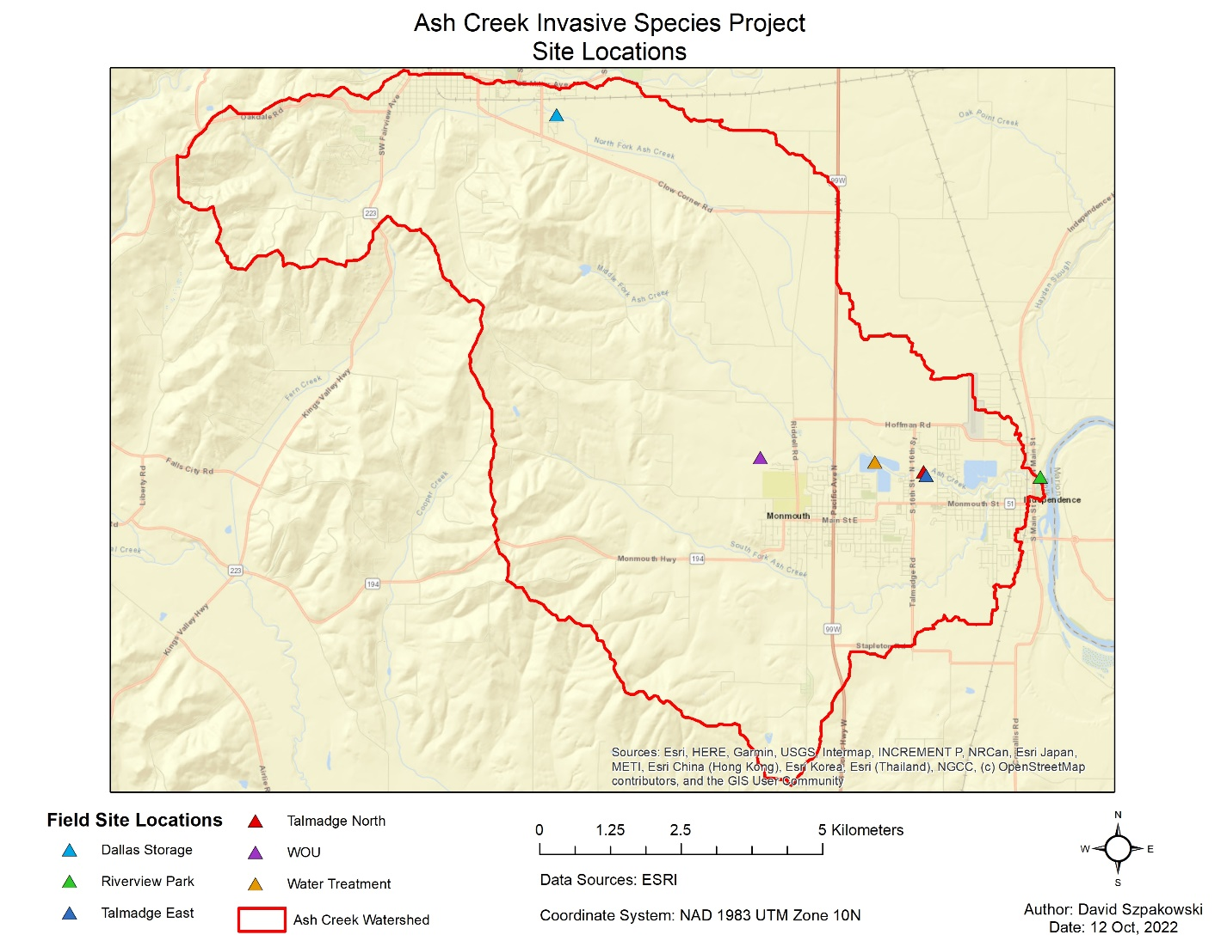
Plant Survey Locations
1. Talmadge North
2. Talmadge East
3. Riverview Park
4. Pioneer Park
5. Dallas Storage
6. Water Treatment
7. WOU Ash Creek
Preserve
Pioneer Park

Slide 6
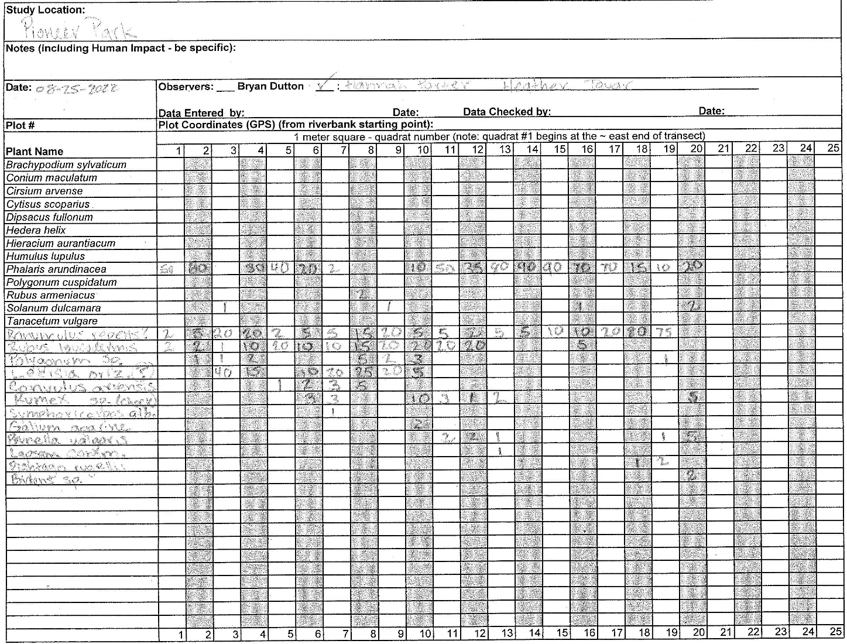
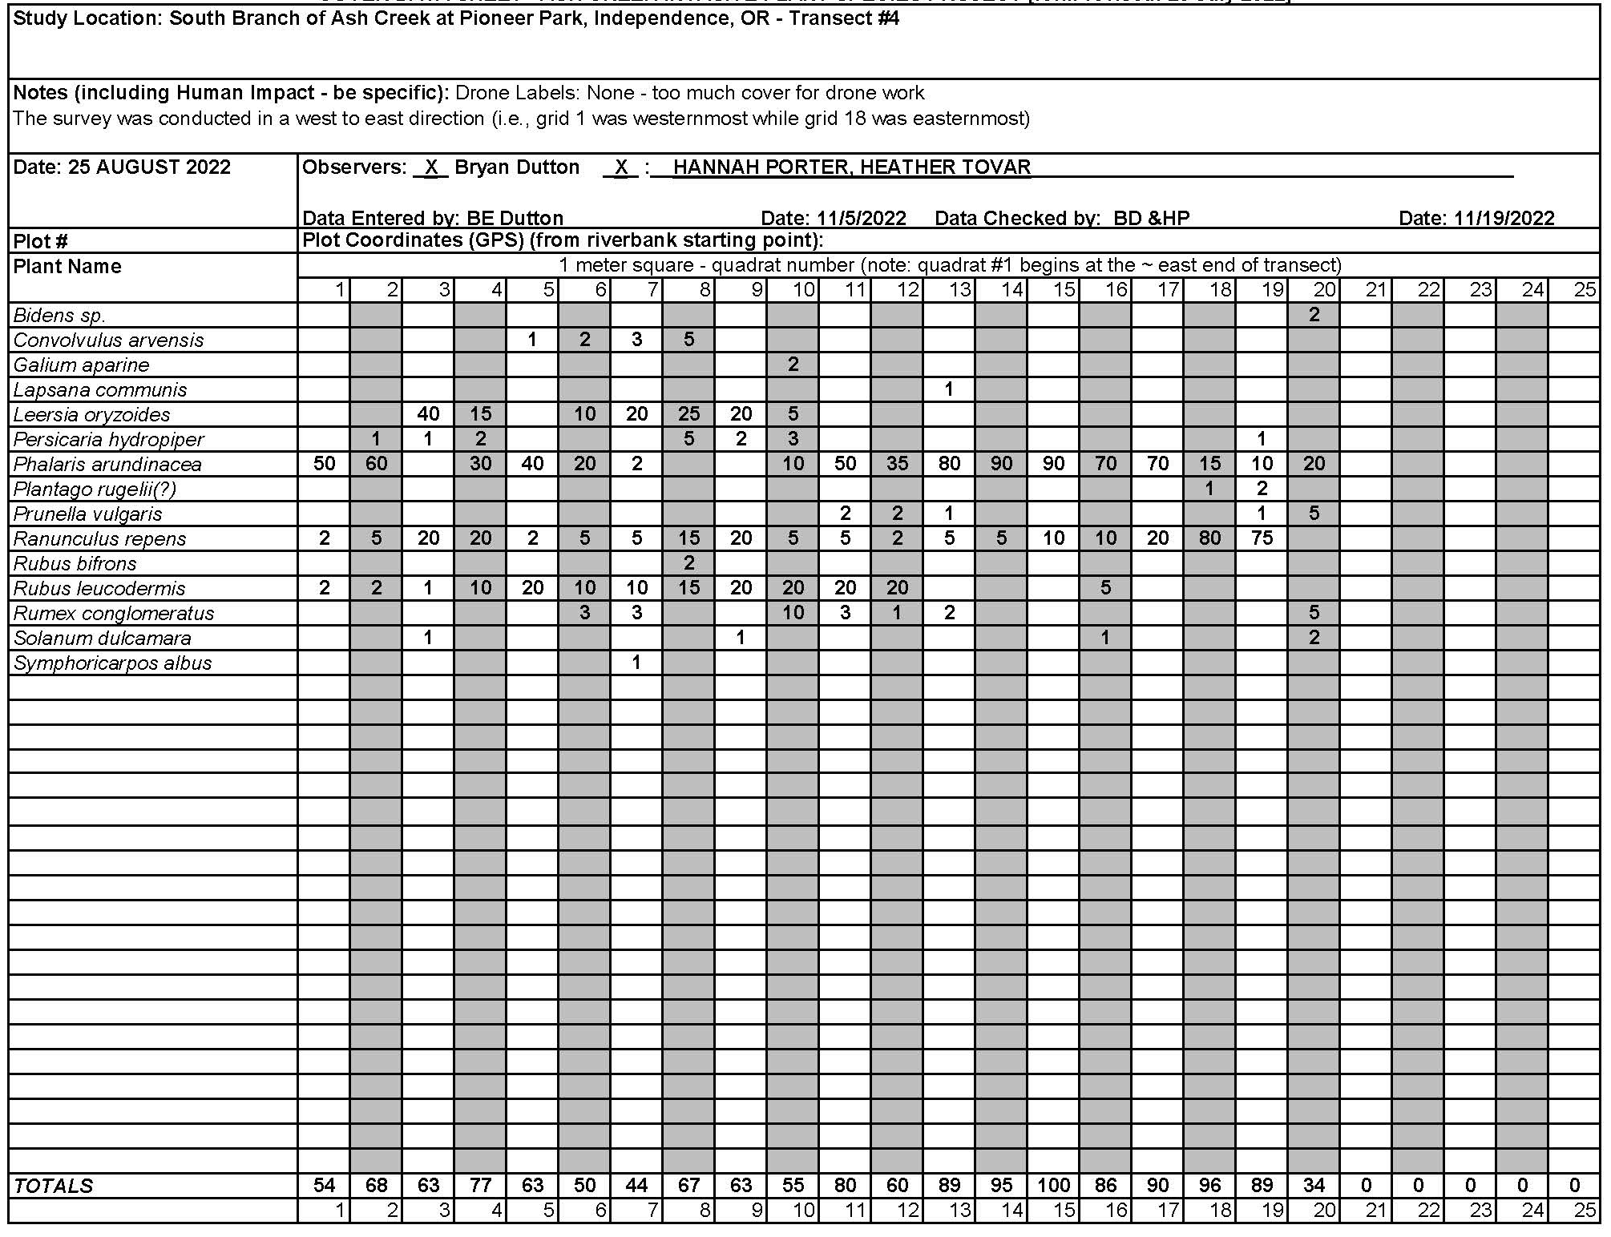
Example Field Data Collection Sheets and Spreadsheet Product

Slide 7
Example Survey Results
Transect 1 (Talmadge North). Percent cover across all measuring grids per taxon; total area = 25 m²; Total taxa n = 20.

Slide 8
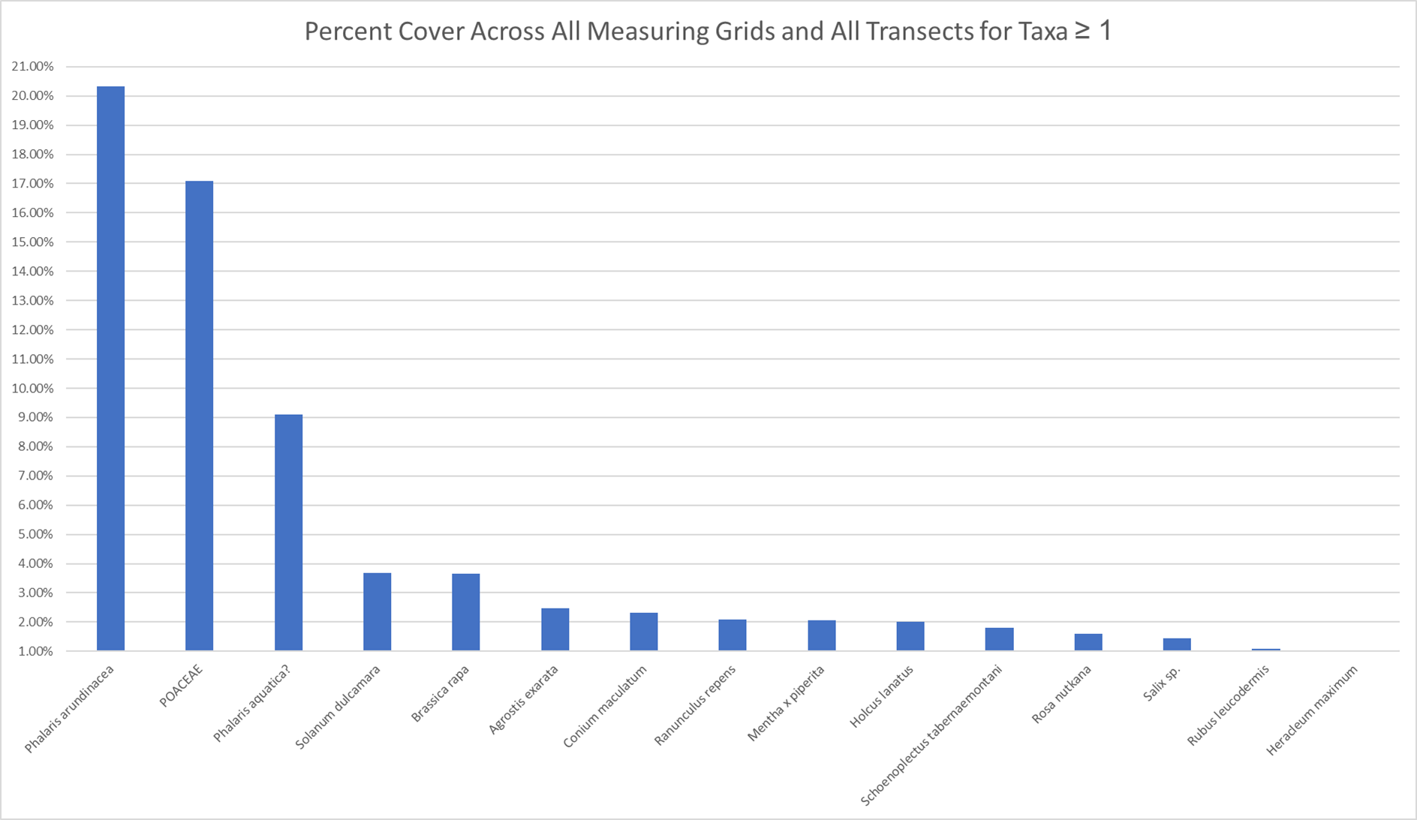

Slide 9
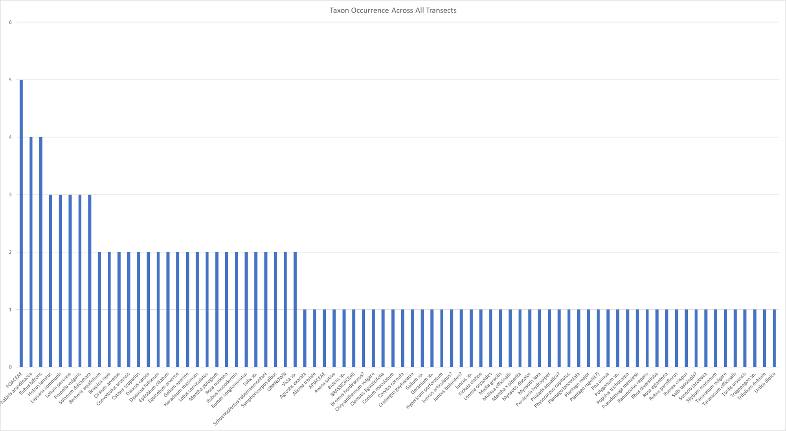
Survey Results: All taxa occurrence across all seven transects; seventy-eight taxa encountered.

Slide 10
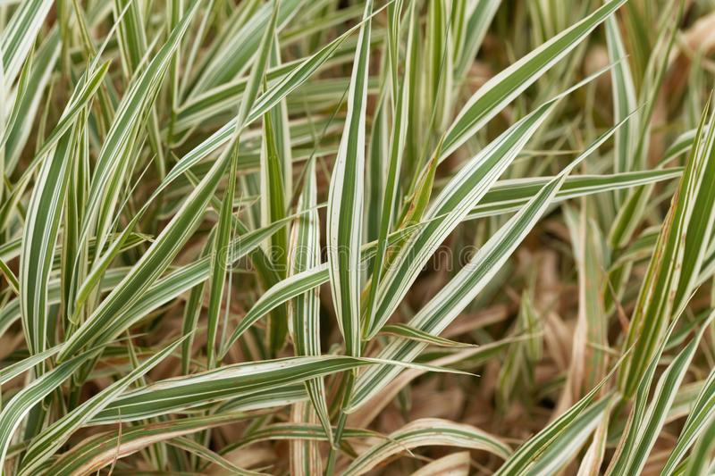
PLANT SURVEY RESULTS
Of the 15 taxa with one percent, or more, cover for the total area surveyed, five (i.e., Phalaris arundinacea L., Poaceae, Phalaris aquatica L., Agrostis exarata Trin., Holcus lanatus L.) are members of the grass family (Poaceae).
Grass family taxa tended to dominate the total percent cover in the transects which they were present.
Three of these five grass taxa (i.e., Phalaris arundinacea L., Poaceae, and Phalaris aquatica L.) are the three most prevalent in terms of total area surveyed.
Poaceae (5 of 7 transects) and Phalaris arundinacea L. (4 of 7 transects) were among the most frequency encountered taxa.

Slide 11
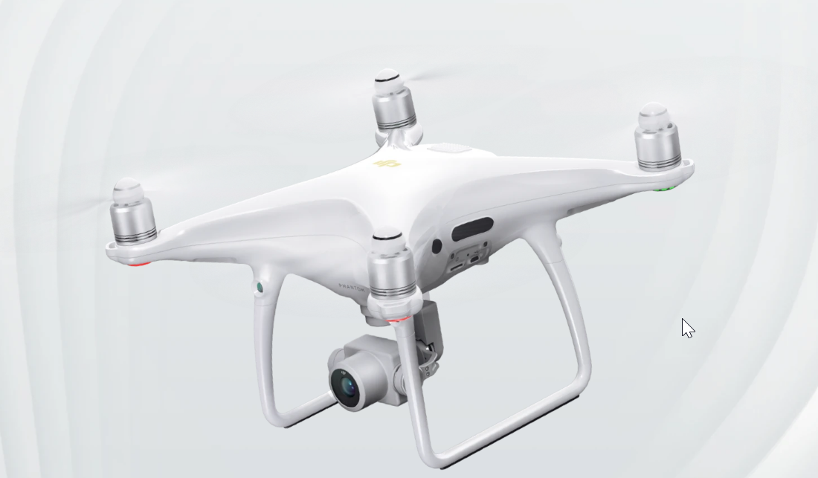
OVERVIEW OF UAV AERIAL IMAGERY RECONNAISSANCE
Methodology
Six field survey sites selected according to property access and tree cover
DJI Phantom 4 Pro V2 UAV was used to collect imagery along plant transects
Ground Control Points established using visible ground targets and GPS
Standardize flight line patterns and settings manually optimized for image quality
  Camera: 1-inch 10MP CMOS sensor
  Altitude: 80 feet
  Flight Speed: 4 mph
  Flight Plans: DroneDeploy Software
Post-Flight Image Processing
  Image mosaics and georegistration
  Final image resolution <0.01 m

Slide 12
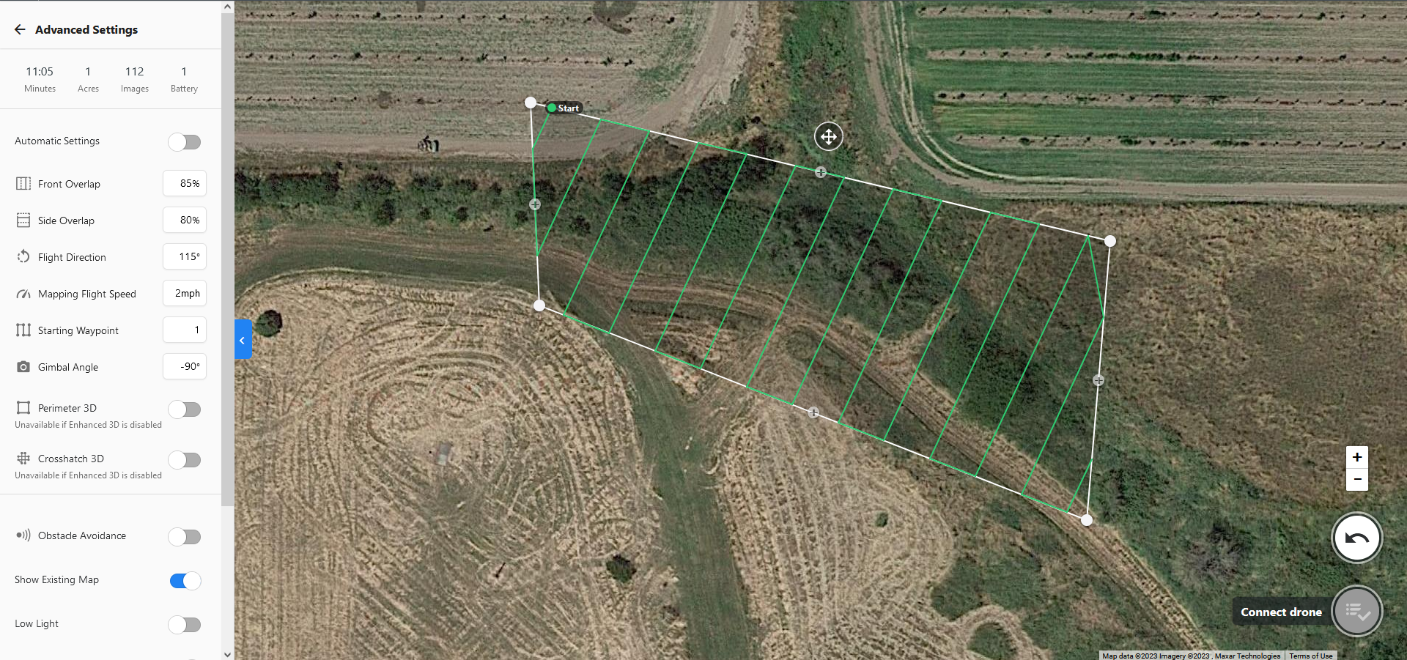
Mission Planning
Notes:
Talk about drone deploy and how you can plan missions in it. Mention some of the variables we found to be important for collecting detailed imagery like:
Shutter Speed (had to set in DJI app and then bring into DronDeploy)
Flight Altitude (typically 80ft)
Overlap in order to ensure adequate coverage
Flight Speed (slow, as seen above. No more than 4mph)

Slide 13
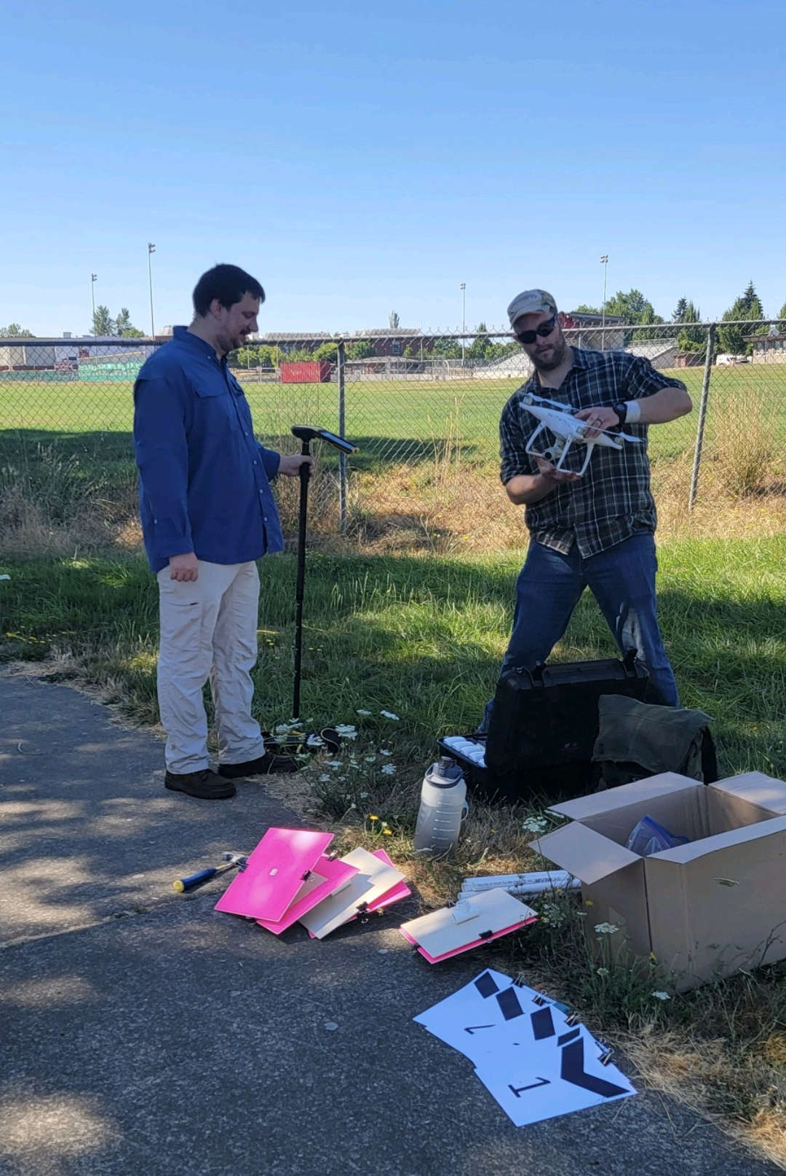
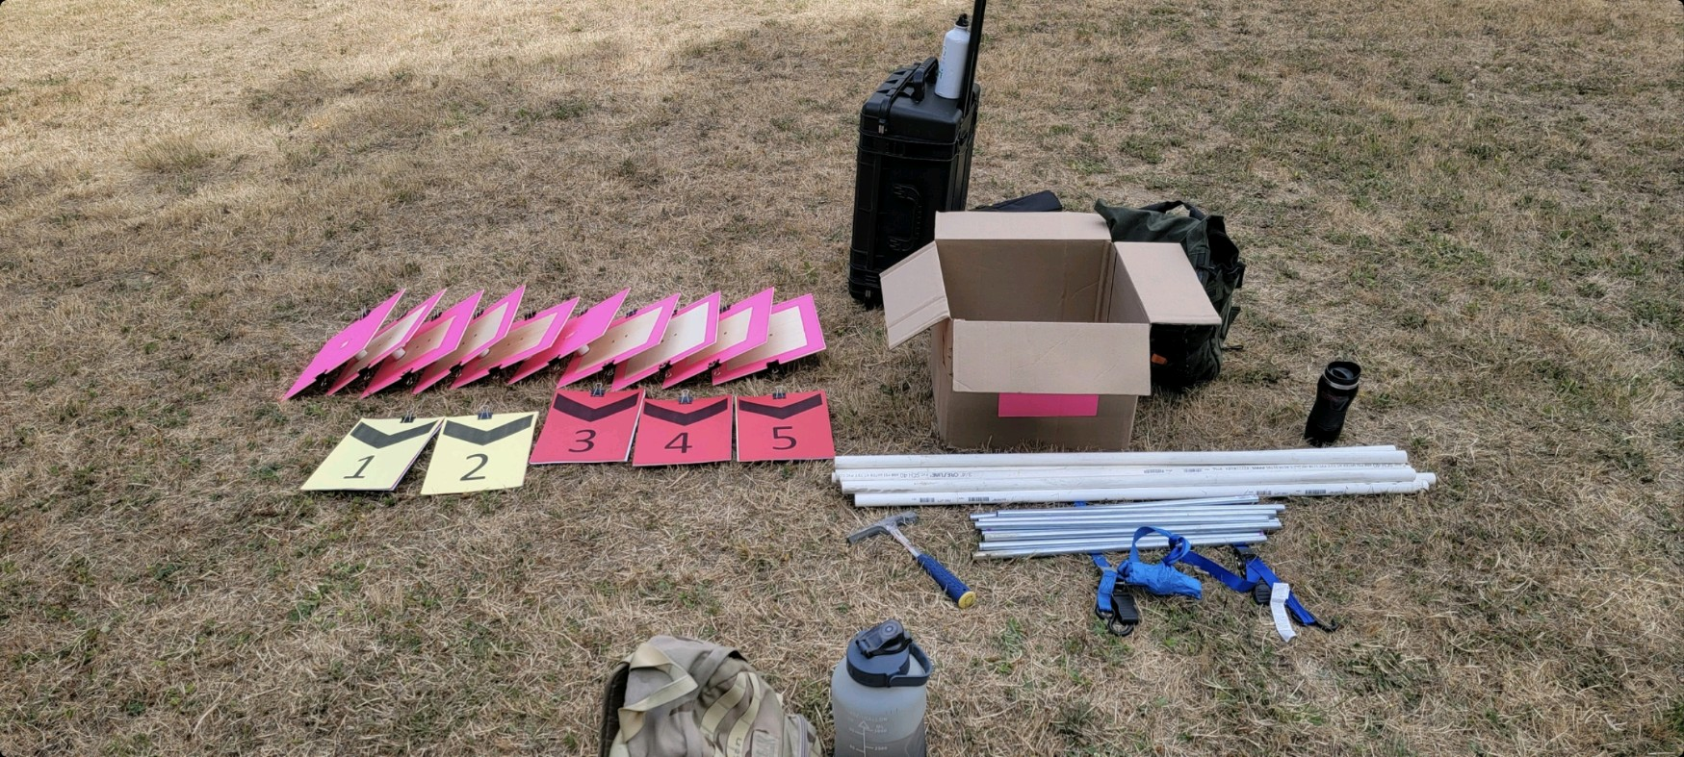
Flight Preparation and GCPs
Notes:
Talk about setting up the drone and establishing GCPs

Slide 14
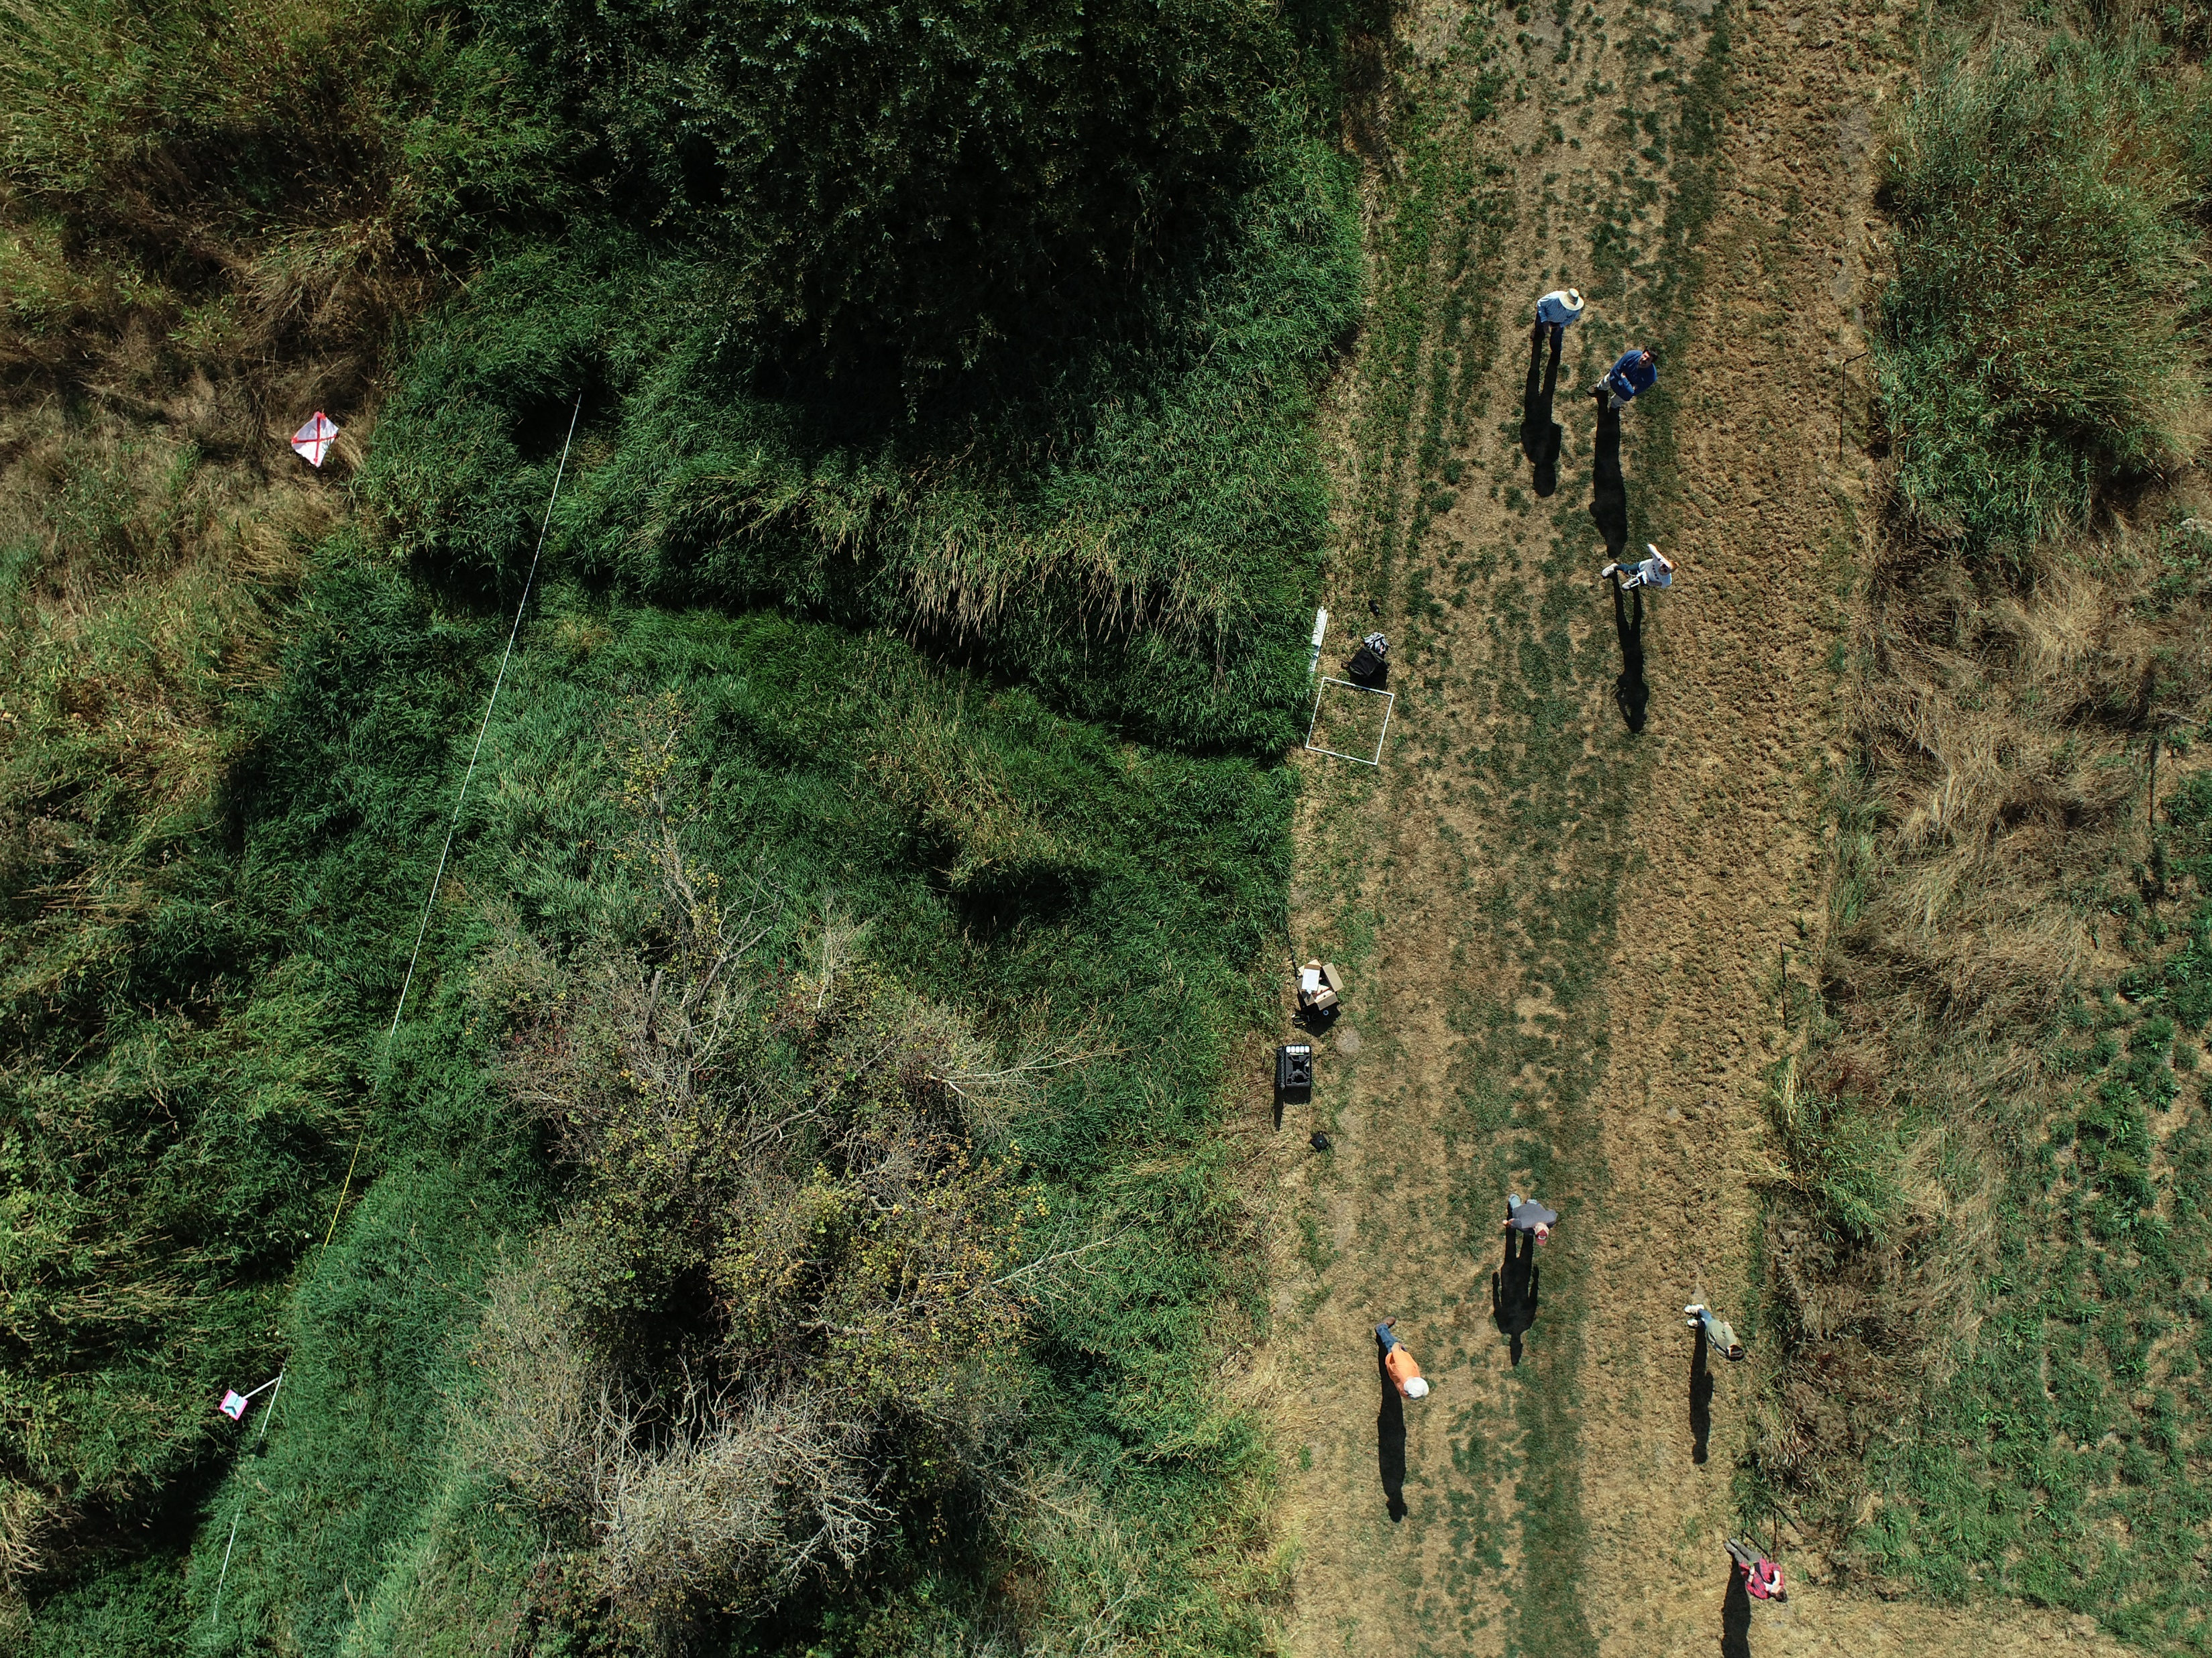
Drone Flight
Notes:
Talk about what flying the drone is like. Most of the audience will have never done this and will be interested in how it works.

Slide 15
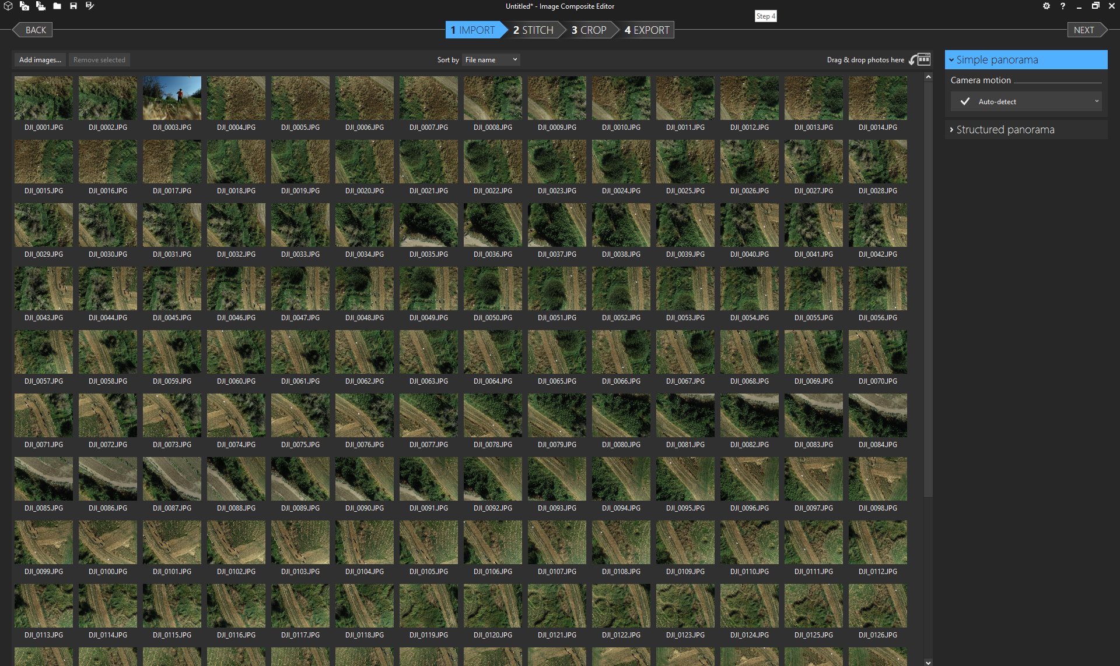
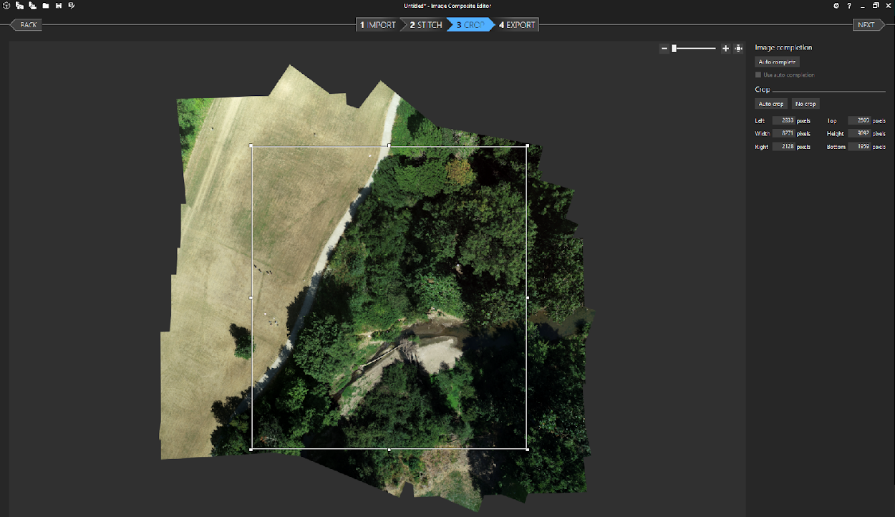
Compiling Mosaic
Notes:
Talk about the image composite process. We used the ICE program, give them a simple walkthrough on how it works.

Slide 16
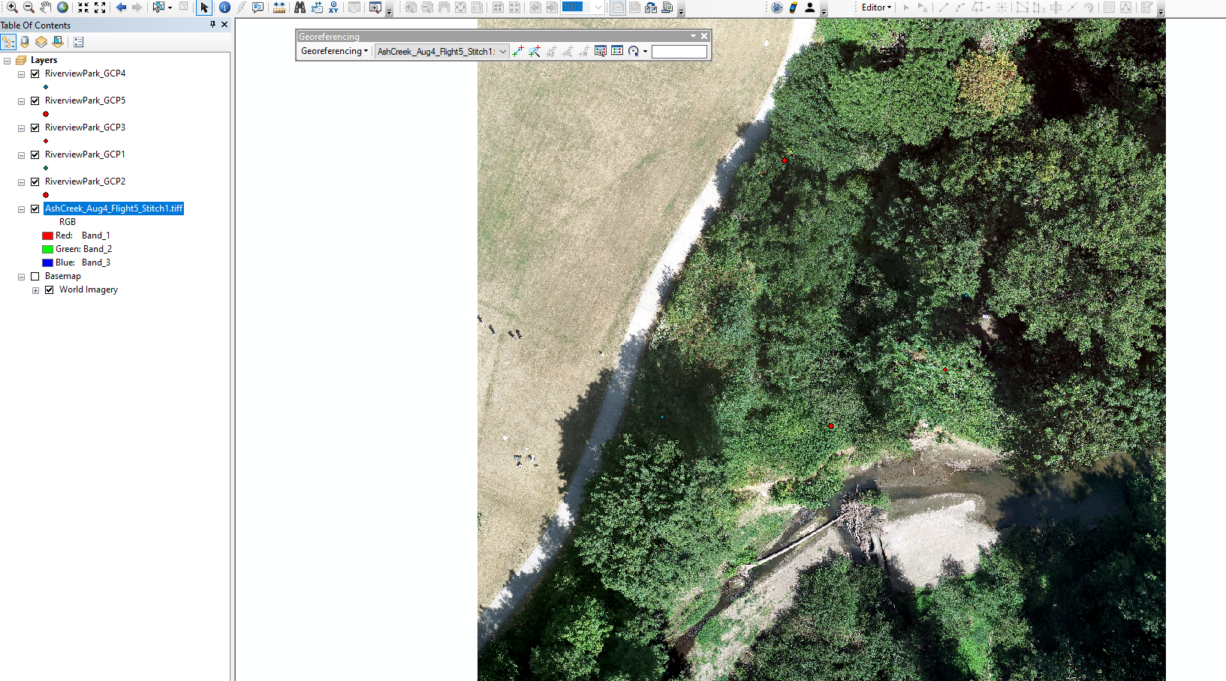
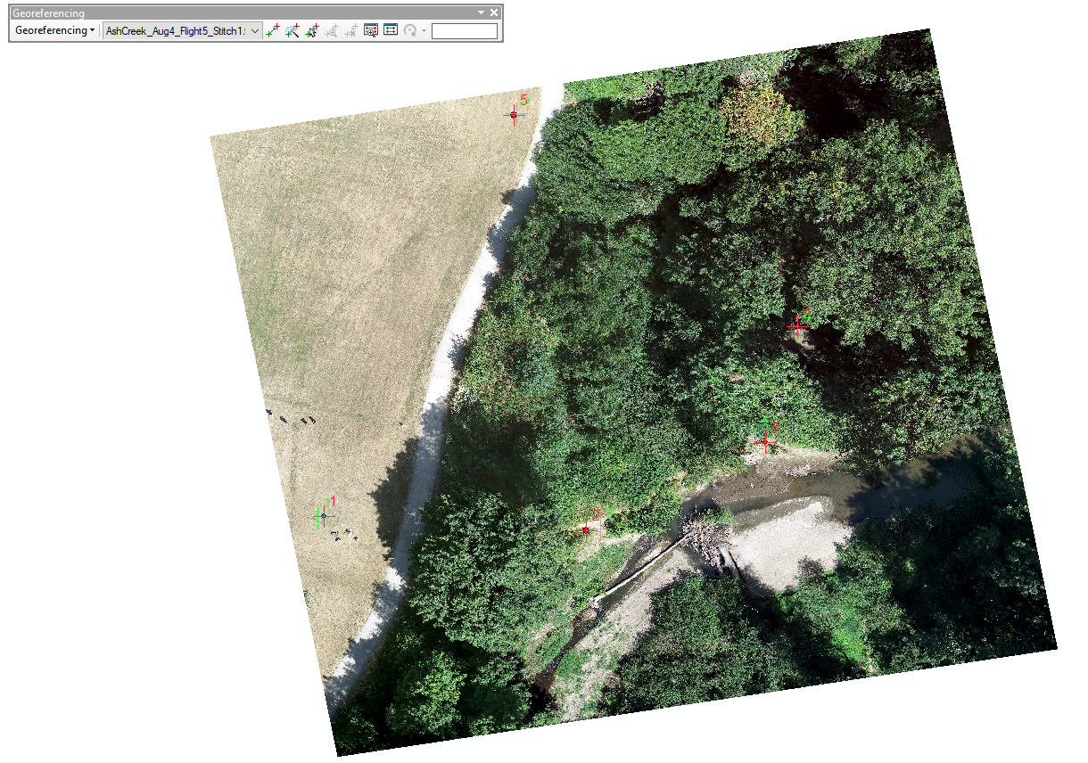
Georeferencing Mosaics
Notes:
Talk about how to georeferenced mosaics and why it is important (e.g. the mosaic will not automatically be associated with its real-world location). Mention how the GCPs tie-in here. Then talk about map creation briefly.

Slide 17
Ash Creek Site Locations for Collection of UAV Imagery
UAV Flight Locations
Dallas Storage
WOU Disc Course
Water Treatment
Talmadge North
Talmadge East
Riverview Park

Slide 18
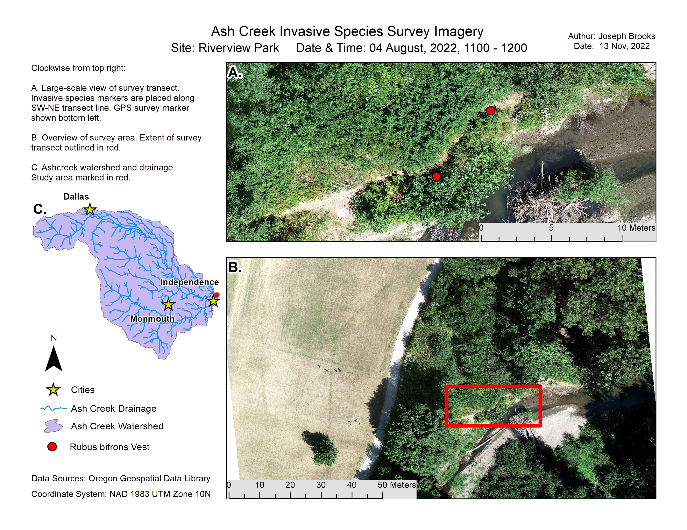
UAV Image Results – Riverview

Slide 19
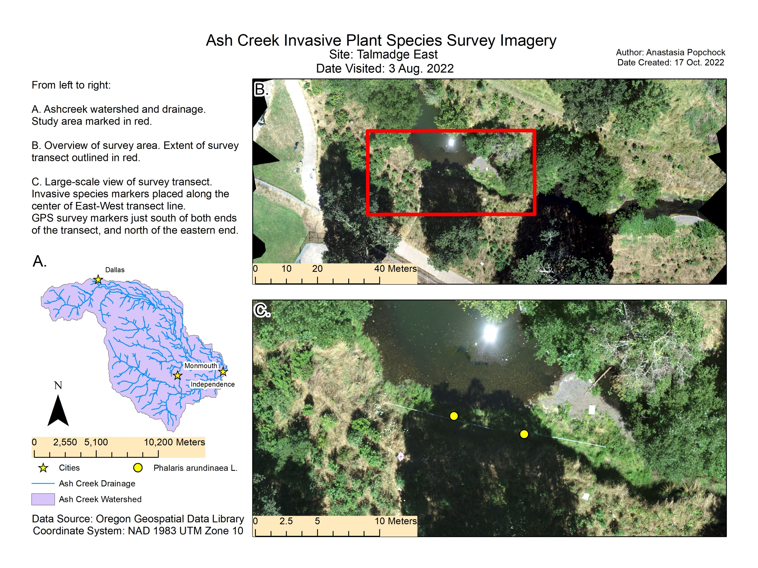
UAV Image Results – Talmadge East Site

Slide 20
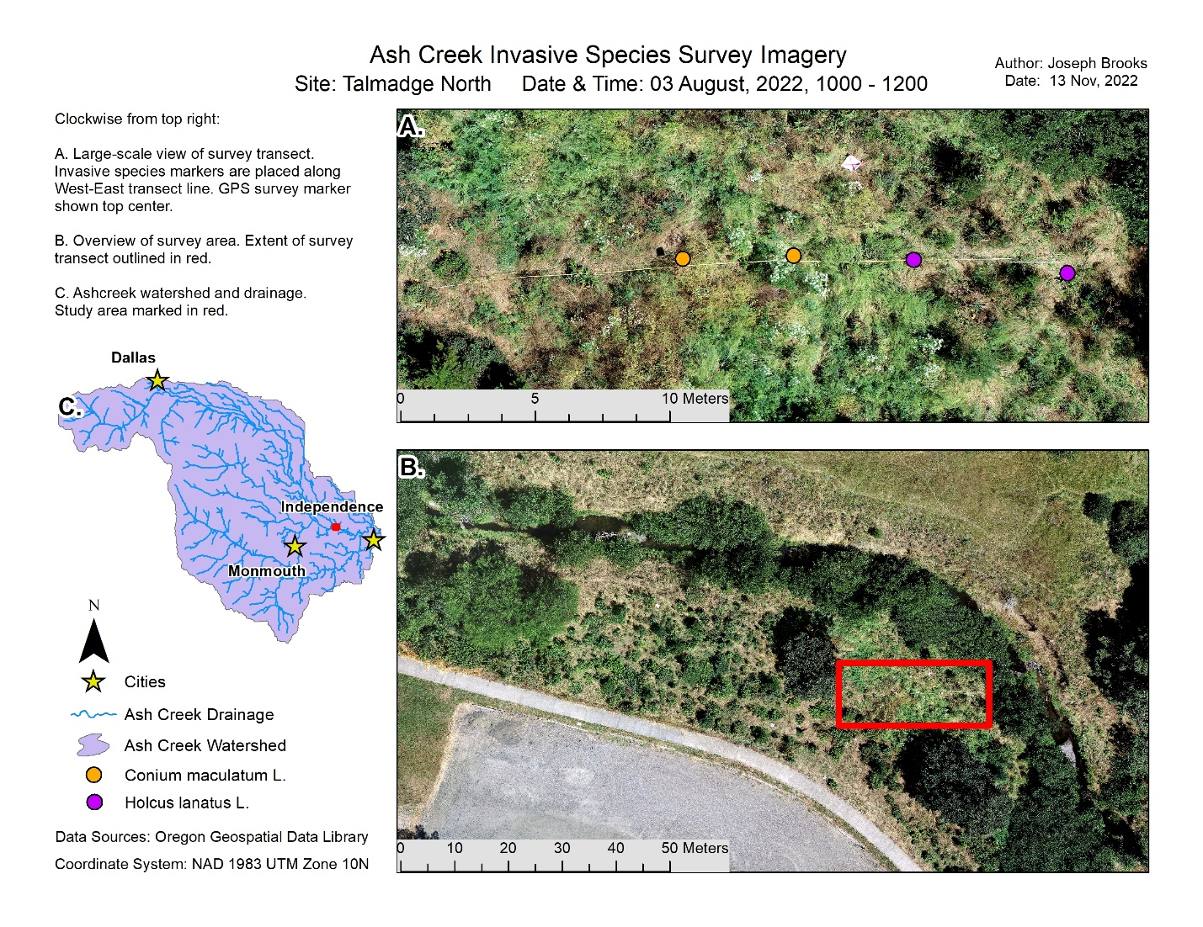
UAV Image Results – Talmadge North Site

Slide 21
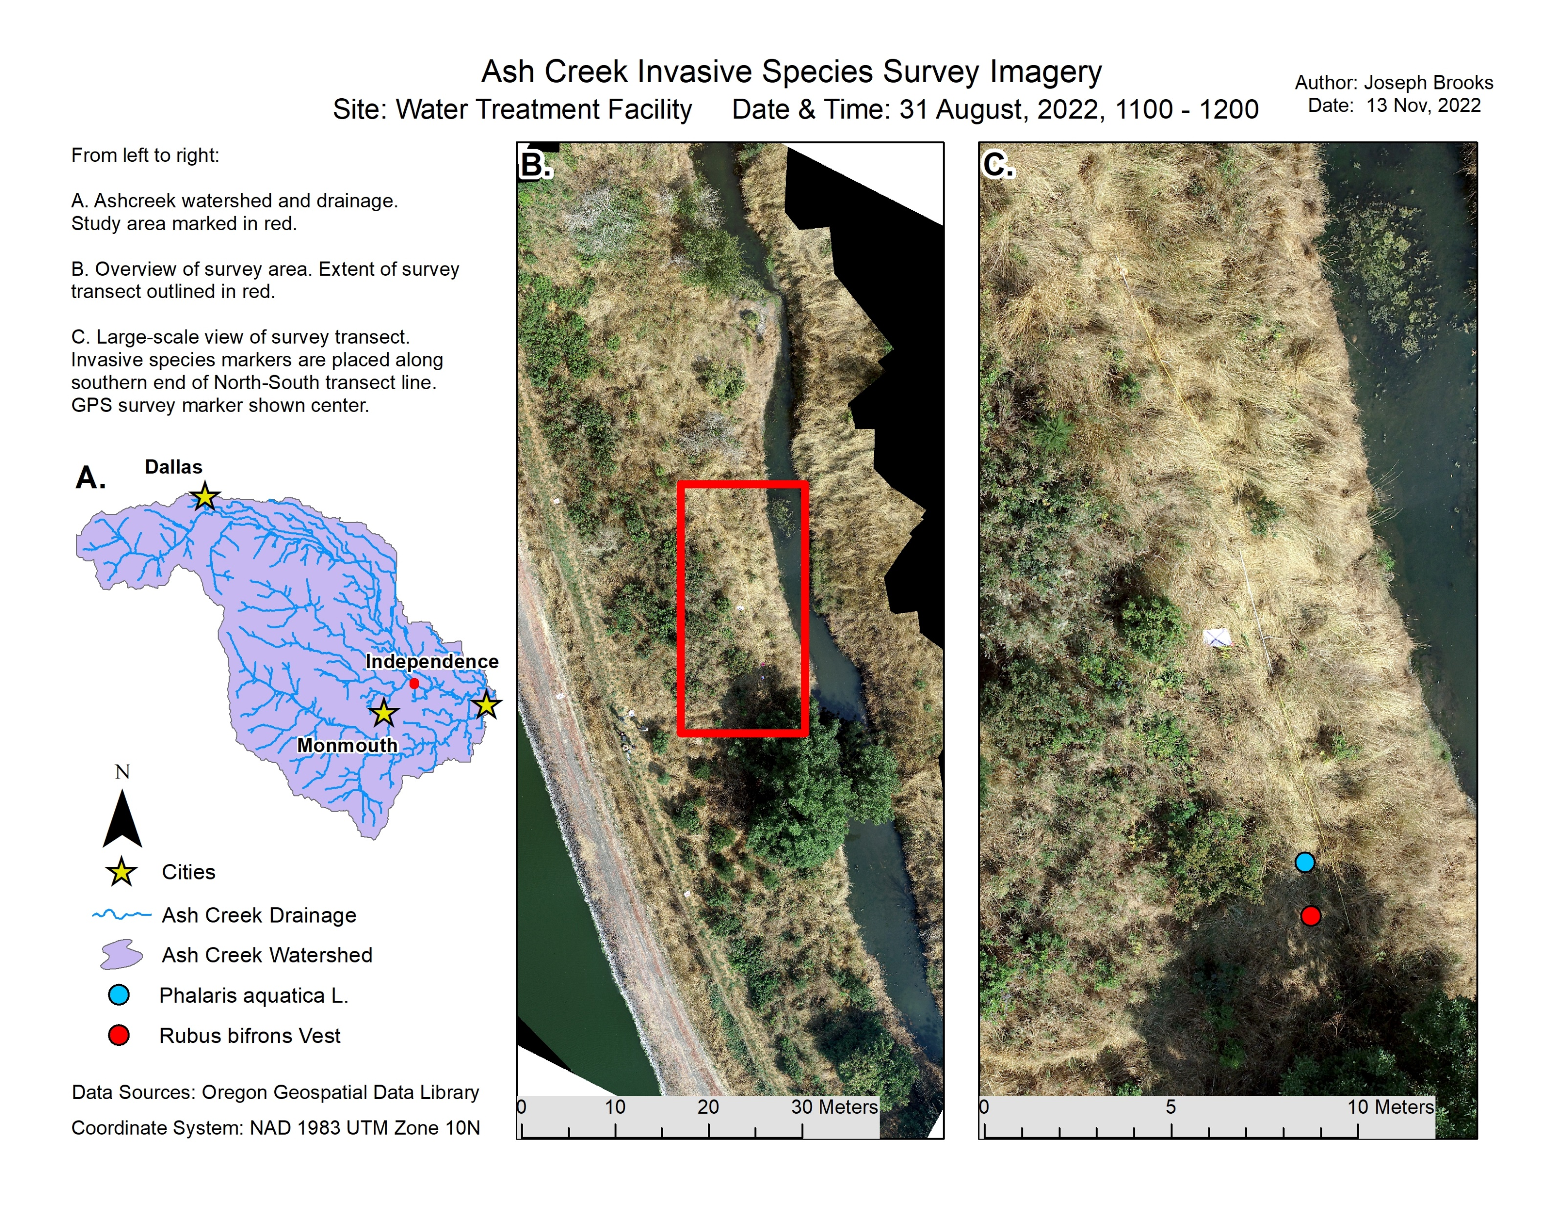
UAV Image Results – Water Treatment Facility

Slide 22
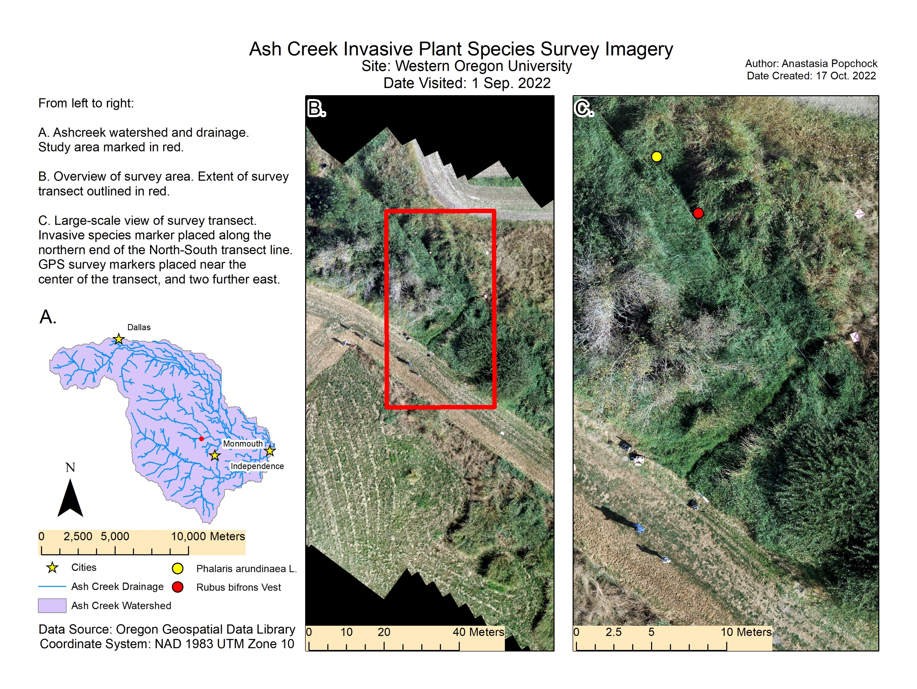
UAV Image Results – Western Oregon University

Slide 23
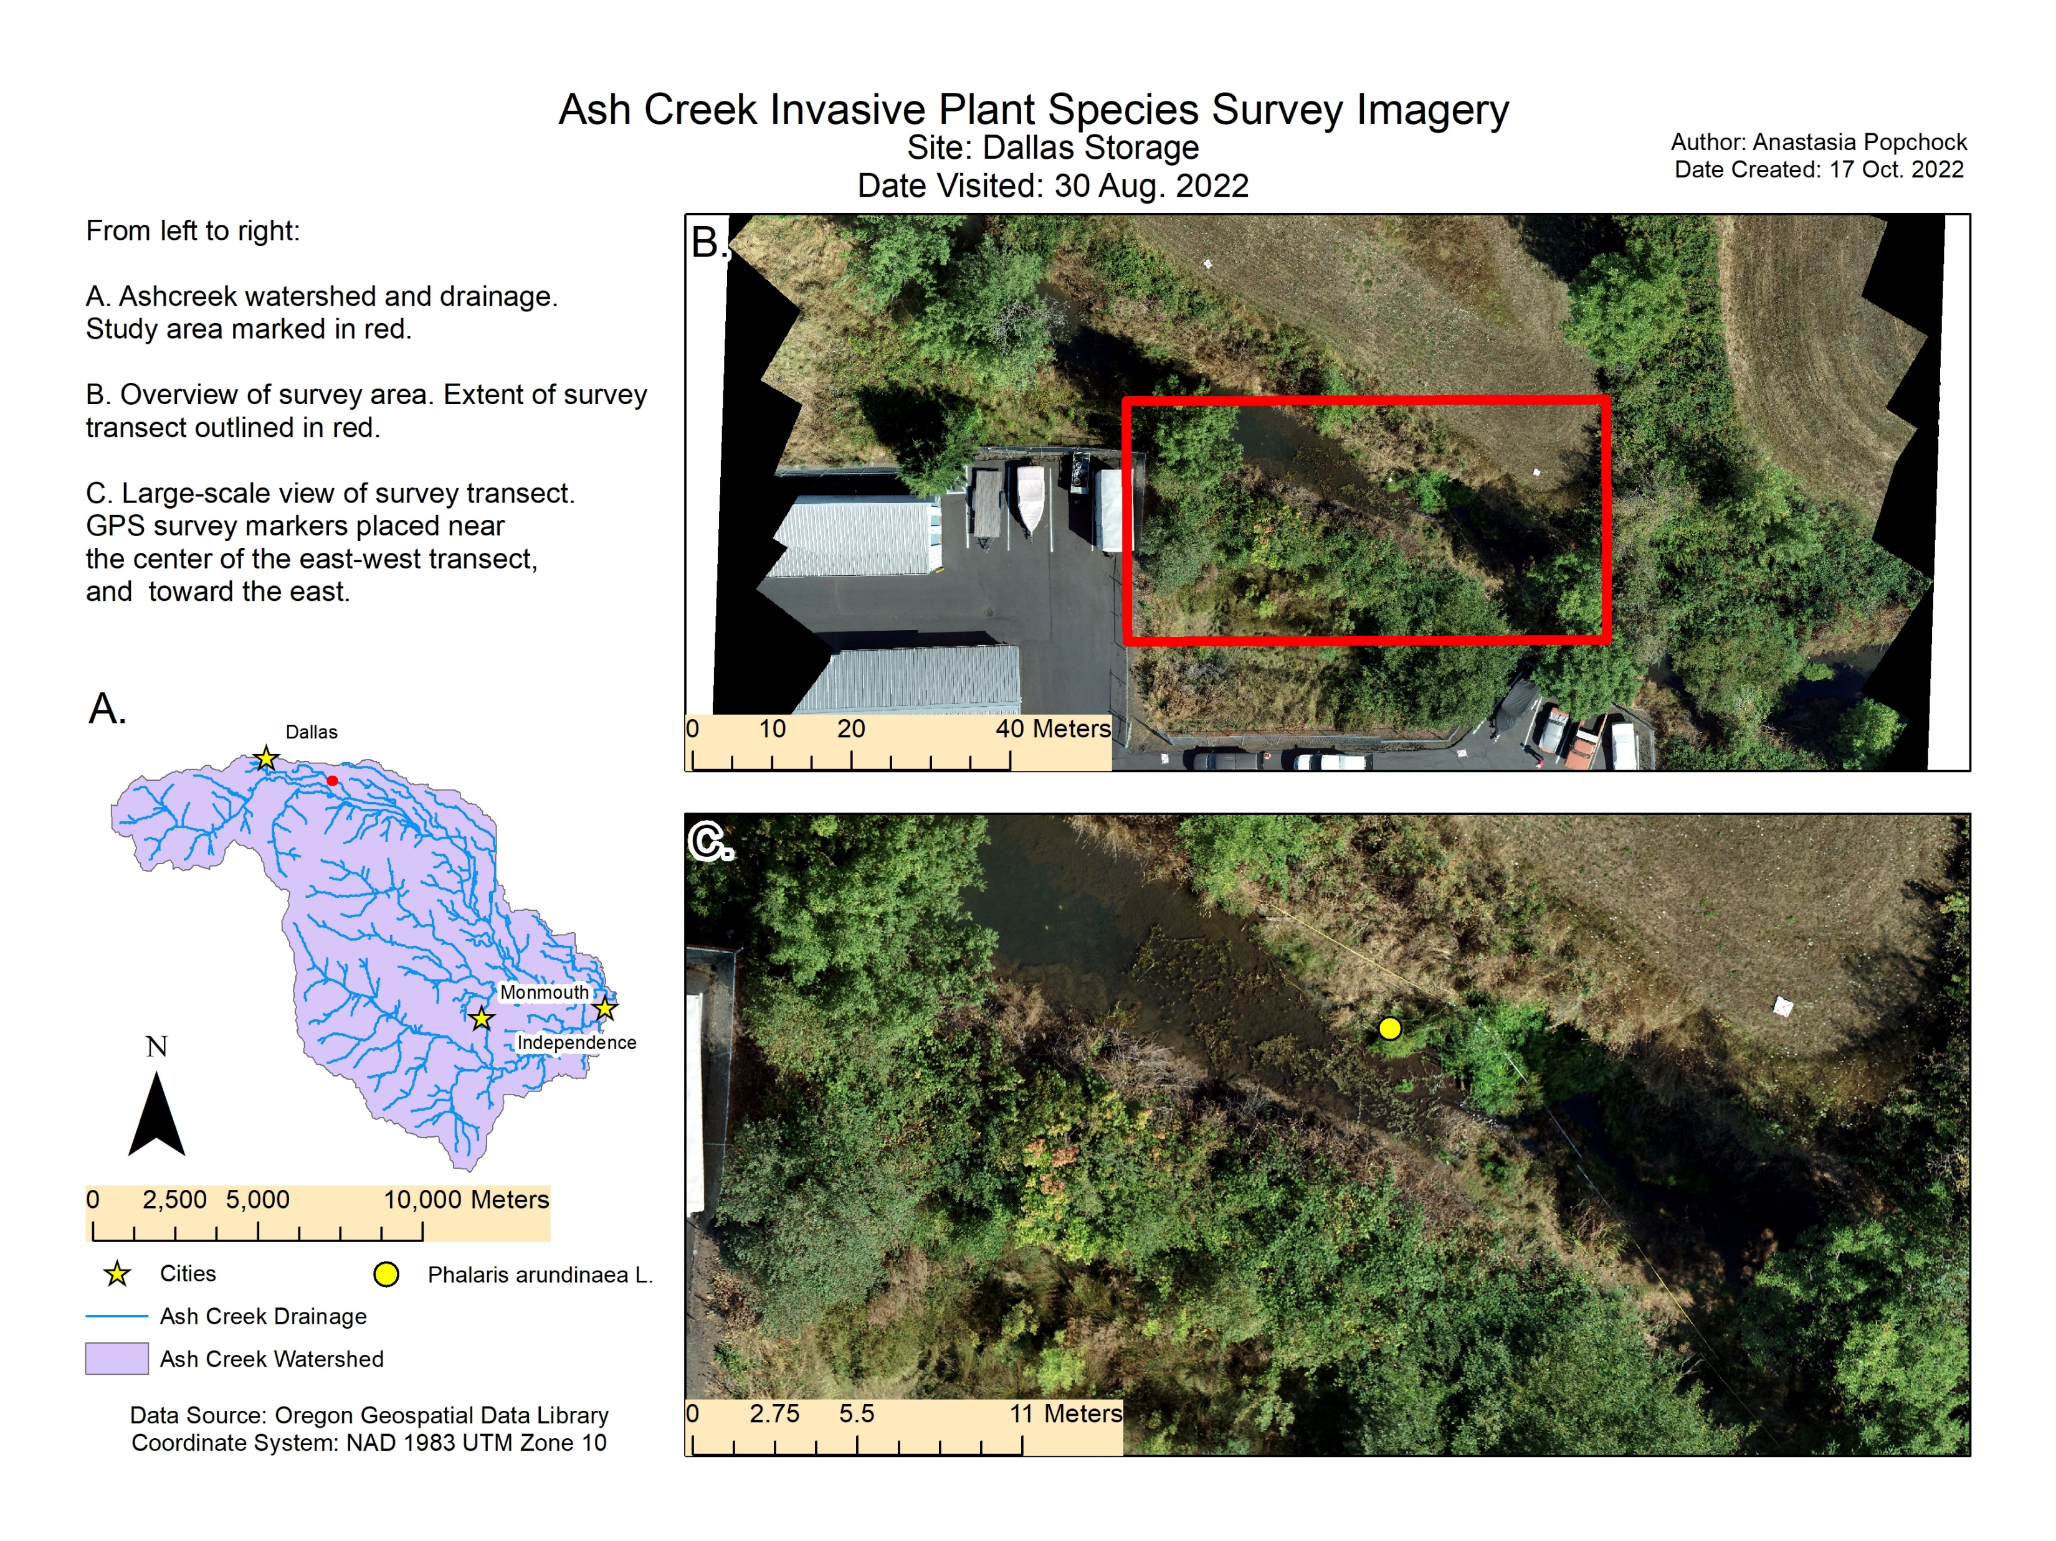
UAV Image Results – Dallas Storage Facility

Slide 24
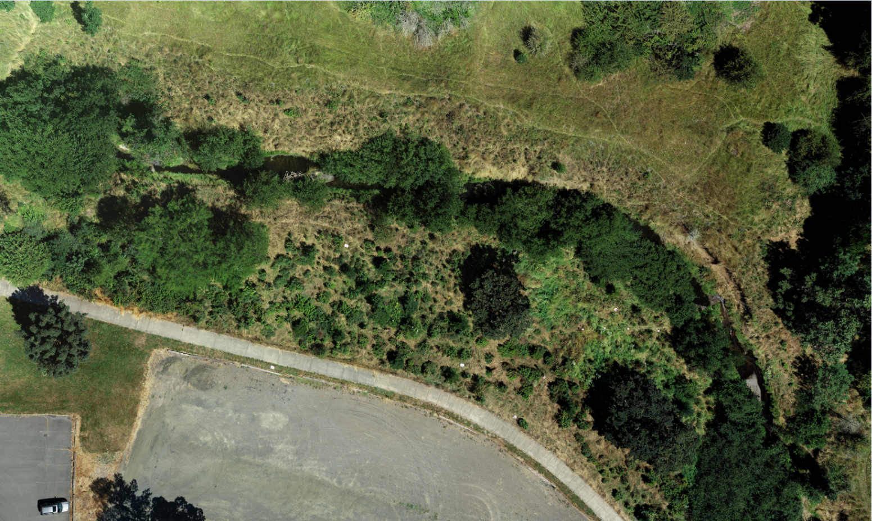
Image Detail Example – Zoomed Out

Slide 25
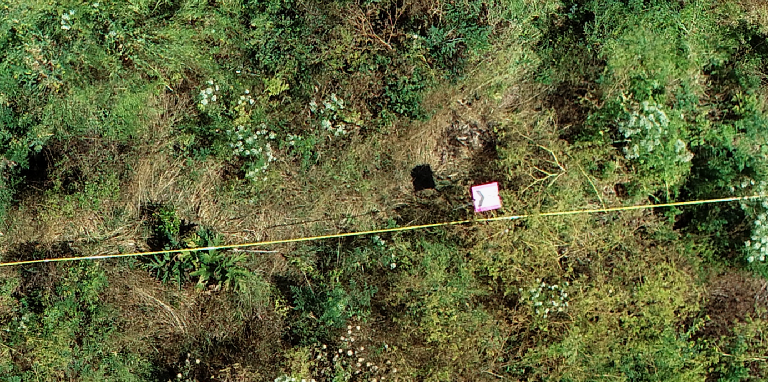
Image Detail Example – Zoomed In

Slide 26
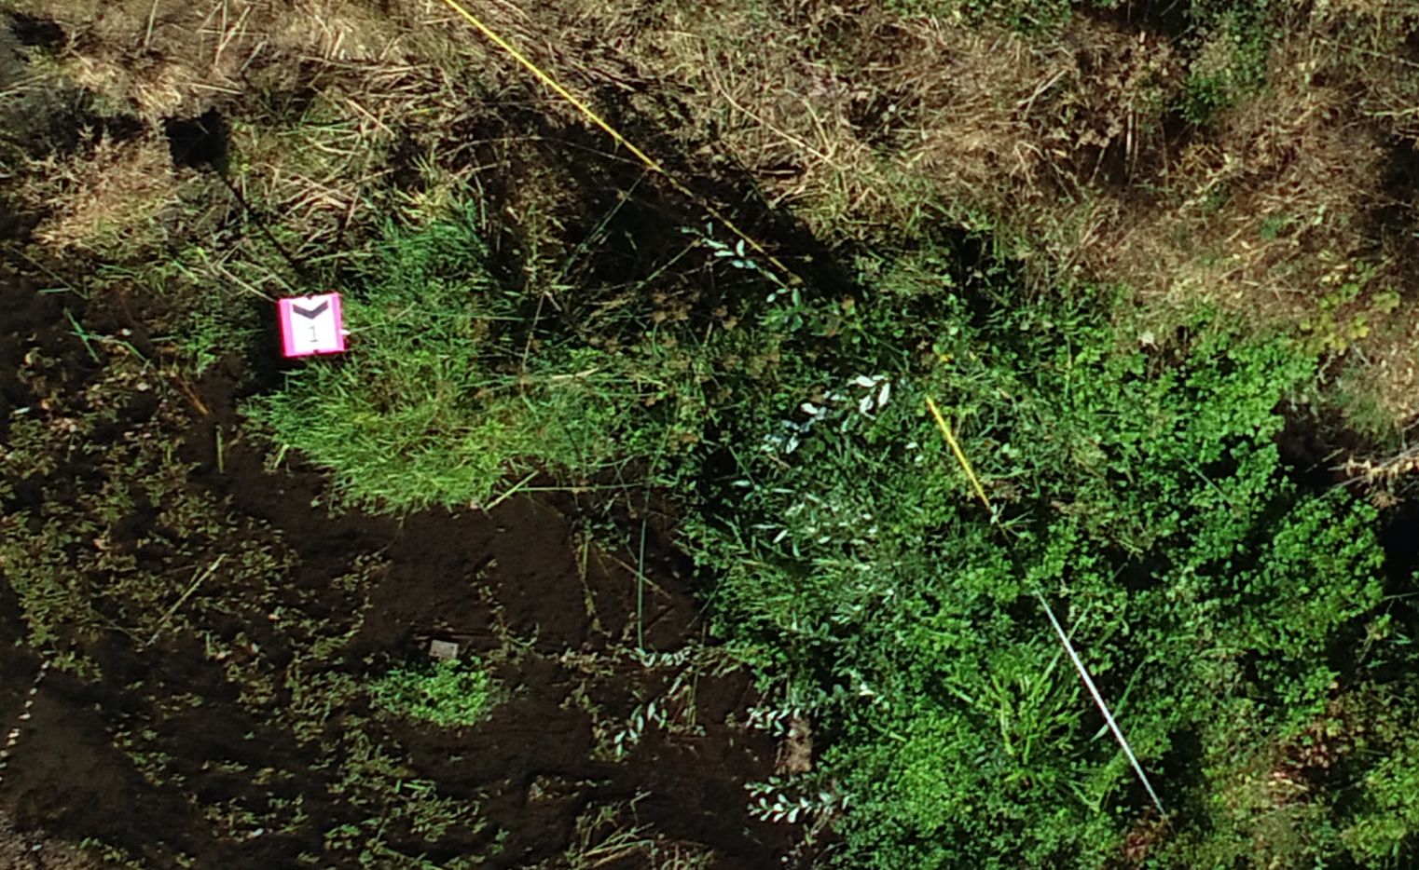
Example of Species Identification in Image

Slide 27
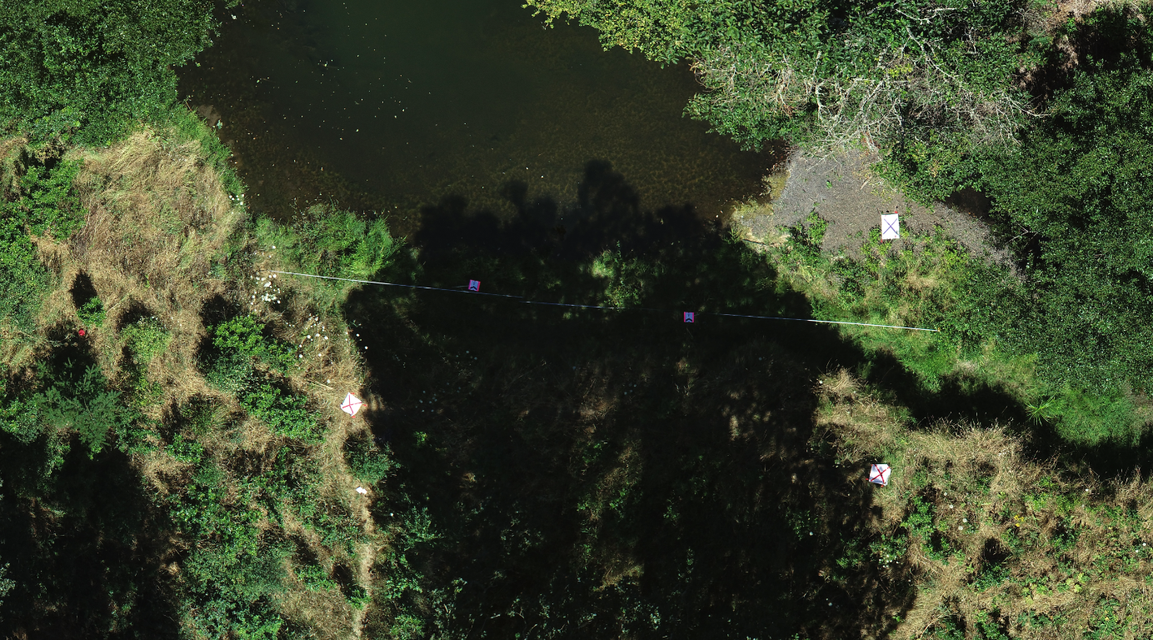
Issues - Shadows

Slide 28
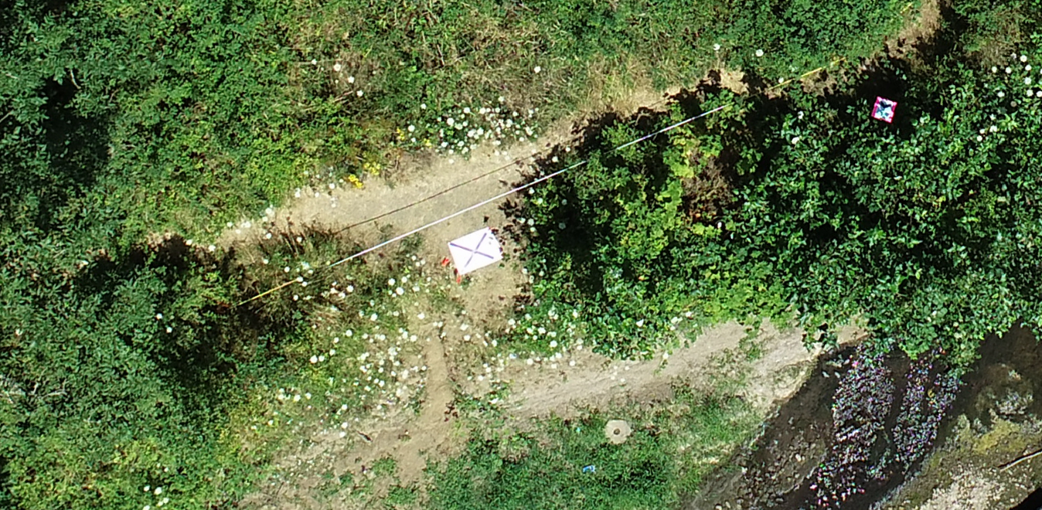
Issues – Flight Altitude

Slide 29
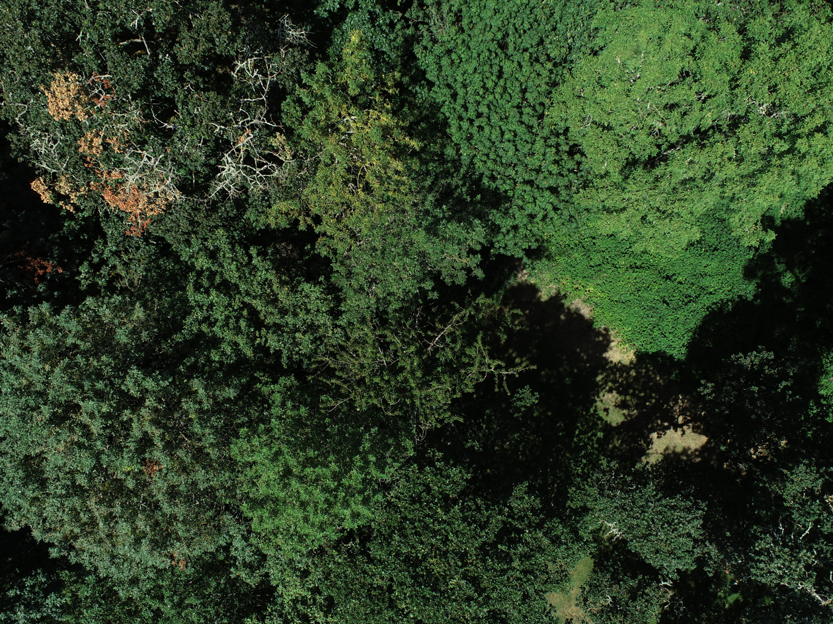
Issues – Canopy Cover

Slide 30
Estimated Equipment Costs for UAV Image Collection
UAV Equipment and Software | Estimated Cost
DJI Phantom 4 drone (or similar UAV) | $1,600.00
Additional UAV Batteries* | $100.00 (each)
High Precision Trimble GPS Unit | $6,000.00 - $7,000.00
Moderate Precision GPS Unit (alternative to high precision GPS) | $1,000.00 - 1,500.00
Carbon Fiber Monopole (for GPS) | $230.00
TerraFlex Advanced (GPS software) | $400.00 (per year)
ArcGIS (Professional Standard License) | $2,750.00 (per year)
Field Equipment (GCP markers, plant markers, transect lines, etc.) | $200.00 (in total)
Minimum Total = $6,150
3 batteries, cheapest GPS, no monopole

Slide 31
UAV IMAGERY RESULTS
UAV imagery provides a methodology for rapid collection of high spatial resolution imagery and facilitates remote logistical access to a wider range of property areas compared to ground-based surveys.
The plant survey team concluded that some of the invasive species of interest were identifiable in the imagery, however others were difficult to distinguish.
Overstory vegetation can be a major limiting factor when determining flight altitude and resulting image resolution.
Adverse weather poses a dangerous flight risk and operational limitation
Season and time of day is an important factor in establishing optimal camera settings to avoid shadowing and loss of image quality.

Slide 32
CONCLUSIONS
1-meter grid field transects provide a robust flora inventory method.
Field surveys provide a rich source of plant data (e.g., cover, density, occurrence, richness).
Field surveys are time-consuming and property access may be limited.
Regular inventorying / monitoring of the drainage is warranted to most accuracy track floristic changes, especially for invasive species remediation.
The use of UAV imagery for invasive plant species identification is promising.
High resolution imagery provides high detail, however plant identification at the species level is variable, ground truthing is recommended.
Other UAV methods for identifying species should be tested, including use of near-infrared sensors and broader-scale image classification techniques.

